Slide 1
Resins and resins combination

Slide 2
Resins and resins combination
The term ‘resin’ is applied to more or less solid, amorphous products of complex chemical nature.
On heating they soften and finally melt.
They are insoluble in water and usually insoluble in petroleum ether but dissolve more or less completely in alcohol, chloroform and ether.

Slide 3
Chemical composition
Chemically, resins are complex mixtures of resin acids, resin alcohols (resinols), resin phenols (resinotannols), esters and chemically inert compounds known as resenes.

Slide 4
Resins are often associated with volatile oils (oleoresins), with gums (gum-resins) or with oil and gum (oleo-gum-resins).
Resins may also be combined in a glycosidal manner with sugars.
Resins burn with a characteristic, smoky flame.

Slide 5
Balsams
Balsams are resinous mixtures that contain large proportions of cinnamic acid, benzoic acid or both or esters of these acids.
The term “balsam” is often wrongly applied to oleoresins and should be reserved for such substances as balsam of Peru, balsam of Tolu and storax, which contain a high proportion of aromatic balsamic acids.

Slide 6
Preparation of resins
Two general classes of resinous substances are recognized and this classification is based on the method used in preparing them:
Natural resins, occur as exudates from plants, produced normally or as result of pathogenic conditions, as for example by artificial punctures e.g. mastic; or deep cuts in the wood of the plant e.g. turpentine, or by hammering and scorching, e.g. balsam of Peru.

Slide 7
Prepared resins; are obtained by different methods. The drug containing resins is powdered and extracted with alcohol till exhaustion. The Concentrated alcoholic extract is either evaporated, or poured into water and the precipitated resin is collected, washed and carefully dried.
In the preparation of oleoresins; ether or acetone having lower boiling point are used. The volatile oil portion is removed through distillation.
When the resin occurs associated with gum (gum-resins), the resin is extracted with alcohol leaving the gum insoluble.

Slide 8
Classification of resins
Resins are classified in three different ways:
Taxonomical classification, i.e. according to botanical origin, e.g. Berberidaceae resins.
Classification according to predominating chemical constituent; e.g. acid resins, resene resins, glycosidal resins; etc.
Resins may be classified according to the portion of the main constituents of the resin or resin combination; e.g. resins, oleoresins, oleogumresins, balsams.

Slide 9
Examples of resins and resins combination
Resins: colophony, cannabis.
Oleoresins: copaiba, ginger.
Oleo-gum-resins: asafoetida, myrrh.
Balsams: balsam of Tolu, balsam of Peru.

Slide 10
Colophony
Synonym-Resin, Rosina, Colophonicum, Amber resin, Pine resin.
B.S-Residue left after distillation, obtained from oleoresin of Pinus palatrus and other species of Pinum.
Family-Pinaceae.
Occurrence-North America, Europe, Pakistan, India.
Composition-contains 90% of resin acid known as abietic acid. component of drug varies according to source and storage condition.

Slide 11

Remaining 10% is resene &ester of fatty acids.
-Drug contains mixture of dihydroabietic acid(C20H20O2) & dehydroabietic acid (C20H30O2).
-On heating at 300⁰C abietic acid undergo molecular rearrangement to produce Neoabietic acid.
Identification Test-
1. One gm powder colophony + dissolve 17 ml of Acetic anhydride+1 drop of H₂SO₄ – gives appearance of purple color which rapidly changes to violet.

Slide 12
2.Alcoholoic solution of colophony is acidic to litmus.
3.Dissolve 0.2 gm colophony in 5 ml of petroleum ether-filter-decant undissolved resin-shake clear solution with twice its volume of 0.1% of cupric acetate.-petroleum ether layer attains emrald green color due to formation copper salt of abietic acid.

Slide 13
Uses-
-Stimulant, diuretic and ingredient of plasters.
-precipitation of ointment
-Industrially used in varnishes, paint, cement, soap, wood polishes and fire work.
-also used in water proofing of cardboard and walls.

Slide 14
Benzoin
Synonym-Loban, Camphor, benzonicum, bitter almond oil, Sumatra benzoin, siam benzoin.
B.S-consist of balsamic resin from genus styrax from various species of Styrax benzoin dryander, S. paralleloneurus Perkins known as Sumatra benzoin, while S. tonkinensis is known as Siam benzoin, S. subdenticulate-Penang benzoin.
Family-Styraceae.
Occurrence-South eastern Asia, Thailand, Vietnam, Sumatra island.

Slide 15
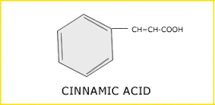
Composition-Major contents are the balsamic acid and their esters.
Sumatra benzoin contains 25% of resin in which 20% is Cinnamic acid and in double concentration of benzoic acid. Also contain triterpene acid –siaresinolic acid, sumaresinolic acid.
Siam benzoin contains lesser amount of cinnamic acid but major component of the resin is comyferyl benzoate (60-70%).Also contains siaresinol benzoate, coniferyl alcohol, cinnamic acid, triterpene siaresionl &vanillin.

Slide 16
Identification Test-
1.Heat small quantity of benzoin(5 gm) with 10% aq potassium permanganate solution-bitter almond like odour is produced due to oxidation of cinnamic acid present in Sumatra benzoin.
2.Alcoholic solution of benzoin with water to give milky white solution.
3.Alcohoic solution of benzoin with FeCl3 -gives green color shows siam benzoin due to presence of phenolic compound coniferyl benzoate

Slide 17
Identification Test-
4.In china dish take 0.2 gm of petroleum ether solution of benzoin+2-3 drops of sulfuric acid-Sumatra benzoin produces reddish brown color where Siam benzoin produces purple red color.

Slide 18
Uses- Siam benzoin
-antiseptic, culinary and expectorant.
-used to prepare benzoinated lard, cosmetics, fixatives and perfumery.
Sumatra benzoin
-expectorant, antiseptic, carminative, stimulant, protective and diuretic.
Used in cosmetic lotion, perfumery and prepared compound benzoin.

Slide 19
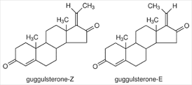
GUGGUL
Synonym-Scented bdellium, gumgugul,salai-gogil.
B.S-Resin obtained by incision of the bark of Commiphora mukul. Family-Burseraceae.
Occurrence-throughout India.
Composition-contains gum (32%),essential oil (1.42%), sterols)guggulsterols I to VI,β-sitosterol, cholesterol Z-&E-guggulsterone),sugars (sucrose,fructose),amino acid,αcamphorene,cembrene,allylchembrol,flavonoids(quercetin & its glycosides),ellagic acid,myricyl alcohol,aliphatic tetrols etc.

Slide 20
Uses-
-significantly lowers serum triglycerides and cholesterol as well as LDL & VLDL cholesterol(bad cholesterol),at the same time increases HDL cholesterol (good cholesterol).
-inhibit platelet aggregation and may increase thermogenesis through simulation of the thyroid, potentially resulting in weight loss.
-Industrially used in varnishes, paint, cement, soap, wood polishes and fire work.

Slide 21
-Also used in water proofing of cardboard and walls.
Also gum is astringent, antirhumatic, antiseptic, expectorant, aphrodisiac, demulcent & emmenagogue.
-resin used in the form of a lotion of indolent ulcers and as gargle in teeth disorders, tonsillitis, pharyngitis, ulcerated throat.

Slide 22
Balsam of peru
Synonym-Peruvian balsam, Indian balsam, China oil, Black balsam, Honduras balsam, surnam balsam, peru balsam, balsamum peruvianum.
B.S-obtained by the incision of the stem of Myroxylon balsumum.Family-Papilionaceae.
Occurrence-Colombia, central America, west Indies.
Composition-Balsamic esters(45-70%) like benzyl cinnamate(cinnamein)(50-60%),benzyl benzoate, cinnamyl cinnamate (styracin).Resin(28%) consisting of peruresinotannol combined with cinnamic and

Slide 23
benzoic acid. alcohols, small amount of vanillin and free cinnamic acid.
Identification Test-
1.Alcoholic solution gives green colour with FeCl3.
2. TLC with ethylacetate shows two main spots of benzylic esters under UV light. 3. TLC sprayed with phosphomolybdic acid shows the presence of nerolidol.
4. It reacts with potassium permanganate to yield benzaldehyde.

Slide 24
Uses-
-used as miticide, to aid in healing of indolent wounds, as scabicide and paracitiside, in skin catarrh,diarrhea,ulcer therapy,local protectant and rubefacient.
-an antiseptic, vulnerary and as a simulating expectorant.
-employed in perfumery and some chocolate flavouring.

Slide 25
Peruvian balsam used as antiseptic, to treat burns, frostbites, cracks, erythema,pruritus,ulcers and wounds.
Suppositories are used in cure pain, pruritus, piles and other anal disorders.
Used as ingredient in cosmetic and hygiene products.
.

Slide 26
Balsam of Tolu
Synonym-Tolu balsam, Thomas balsam, Opobalsam, Resin tolu, balsam of tolu, balsamum tolutanum.
B.S-obtained by the incision of the stem of Myroxylon balsumum.Family-Papilionaceae.
Occurrence-Colombia, Cuba, peru, west Indies.
Composition-contains resin(80%) which is a mixture of resin alcohols combined with cinnamic and benzoic acid. aromatic acid (8-15%)in free state. other constituents are benzyl benzoate, benzyl cinnamate,

Slide 27
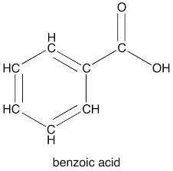
Vanillin, styrene, eugenol,ferulic acid ,sesquiterpenes hydrocarbons, alcohols,triterpenoids. also contain balsamic acid.(35-50%)
Identification Test-
1.Alcoholic solution gives green color with FeCl3 due to toluresinotannols.
2.Alcoholic solution of tolu balsam is acidic to litmus paper.
3. Filtered solution of tolu balsam(1 gm) in 5 ml water-add aq. Potassium permanganate solution is added

Slide 28
Heated for 5-10 min-odour of benzaldehyde due to oxidation of cinnamic.
Uses-
-used as expectorant,stimulant and antiseptic
-used as an ingredient of cough mixtures and compound benzoin tincture.
-employed as pleasant flavouring agent in medicinal syrups,confectionary,chewing gums and perfumery.

Slide 29
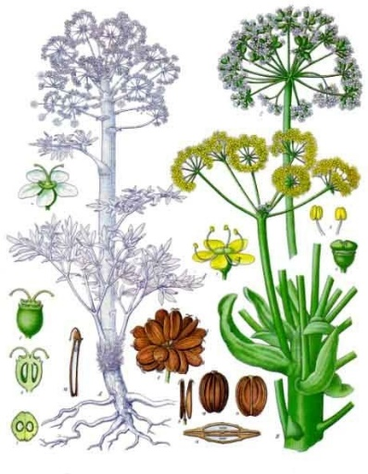
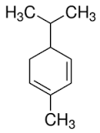
Asafoetida
Synonym- Devil’s dung, food of the gods,asafoda,asant,Hing.
B.S-Is an oleo-gum resin obtained as an exudation by incision of the decapitated rhizome and roots of Ferula asafoetida.
Family-Apiaceae.
Occurance- Iran,Turkestan,Afghanistan.
Composition-contains volatile oil (4-20%),

Slide 30
Resin (40-65%) and gum (25%),garlic like odour of the oil is due to the presence of Sulphur compounds. The main constituent of the oil is isobutyl propanyl disulphide. Also contains phellandrene, sec-butylpropenyl disulphide, geranyl acetate, bornyl acetate,α-terpineol, myristicacid,camphene,myrecene,limonene,fenchone,eugenol,linalool,geraniol,isoborneol,borneol,guaiacol,asafoetidine,foetidine etc.

Slide 31
Chemical test-
1) On trituration with water it produces a milky emulsion.2) The drug(0.5)is boiled with hydrochloric acid(5 ml) for sometime.it is filtered and ammonia is added to the filtrate. a blue fluorescence is obtained.3) To the fractured surface add 50% nitric acid. green color is produced.4) To the fractured surface of the drug, add sulphuric acid (1 drop).A red colour is obtained which changes to violet on washing with water.

Slide 32
Uses-
-carminative, expectorant, antispasmodic and laxative.
-For flavouring curries, sauces, and pickles.
-As an enema for intestinal flatulence in hysterical and epileptic affections.
-In cholera, asthma, whooping cough, Chronic bronchitis.

Slide 33
MYRRH
Synonym-Gum-resin Myrrh, Gum Myrrh, Arabian or Somali Myrrh, Myrrha.
B.S-Is an oleo-gum resin obtained from stem of Commiphora molmol.
Family-Burseraceae.
Occurance- Arabian peninsula, ethiopia, Nubia, Somaliland.
Composition-contains Resin (25-40%),gum (57-61%),volatile oil (7-17%).Large portion of the resin is

Slide 34
Ether soluble containing α-,β- and γ-commiphoric acids,resenes,the esters of another resin acid and two phenolic compounds. the volatile oil is a mixture of cuminic aldehyde, eugenol, cresol, pinene, limonene, dipentene and two sesquiterepenes. Disagrreable odor due to presence of disulphide.
Gum contains proteins(18%) and carbohydrate(64%) which is a mixture of galactose, arabinose, glucouronic acid and an oxidase enzyme.

Slide 35
Chemical test-
A yellow brown emulsion is produced on trituration with water.
Etheral solution of myrrh turns red on treatment with bromine vapors. the solution becomes purple with nitric acid.
Uses-
-Carminative, in incense and perfumes.
-local stimulant and antiseptic properties.

Slide 36
-use in tooth powder and mouth wash.
-it is astringent to mucous membrane.
-It is used in a tincture, paint, gargles and rinse due to its disinfectants, deodorizing and in inflammatory conditions of the mouth and throat.
-Alcoholic extracts are used as fixatives in the perfumery industry.

Slide 37
Cannabis
Synonym- Cannabis indica, Indian hemp, Indian Cannabis, Ganja, hashish,bhang,Marihuana.
B.S- Consist of dried flowering tops of pistillate plants of Cannabis sativa Linn.
Family-Cannabinaceae.
Composition-contains 15-20 % resin, which are amorphous, semisolid, brown coloured, soluble in ether, alcohol and carbon disulphide.
Most important constituents is cannabidiol,

Slide 38
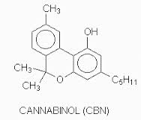
cannabidiolic acid, cannabinol,cannabichromene and trans tetrahydrocannabinol.
-also contains cannabidiolic acid, cannabidiol, tetrahydrocannabinol, volatile oil, trgonelline and choliene.

Slide 39
Uses- Tonic,sedative,analgesic,intoxicant,stomachic,antispasmodic,antianxiety,anticonvusant,antitussive,narcotic.
Marketed product-
Bilwadi churna -Baidyanath

Slide 40
Ginger
Synonym- Rhizoma zingiberis,Zingibere.
B.S- Consist of dried rhizomes of the Zingiber officinale Roscoe. Family-Zingiberaceae.
Composition-contains 1-2 % volatile oil,5-8% pungent resinous mass and starch, the volatile oil is responsible for the aromatic odour and the pungency of the drug is due to yellowish oily body called gingerol which is odourless.
The volatile is composed of sesquiterpene hydrocarbon

Slide 41
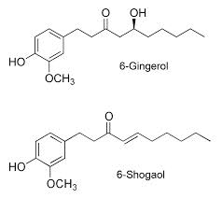
Like α-Zingiberol, α-sesquiterpene alcohol, α-bisabolene, α-farnesene, α-sesquiphellandrene. Less pungent component like gingerone and shogaol are also present.
-shogaol is formed by the dehydration of gingerol and is not present in fresh rhizome.

Slide 42
Uses- Antiemetic, Positive ionotropic, spasmolytic, aromatic stimulant, carminative, condiment and flavouring agent. Prescribed in dyspepsia flatulent colic,Vomiting spasms,cold,cough,asthma.
Marketed product-
Abana, Gasex-Himalaya drug company.
Hajmola-Dabur
Strepsils-Boots piramal healthcare.

Slide 43
Turmeric
Synonym- Saffron indian,Haldi,Curcuma,Rhizoma curcumae.
B.S- Consist of dried rhizomes of the Curcuma longa Linn. Family-Zingiberaceae.
Composition-contains yellow colouring matter called as curcuminoids (5%) and essential oil(6%).
-chief constituents if colouring matter is curcumin I (60%) in addition with small quantities of curcumin II, curcumin III and dihydrocurcimin.

Slide 44
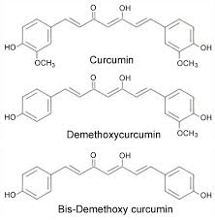
The volatile oil contains mono and sesquiterpenes like zingiberene (25%),α-phellandrene, sabinene, turmeron, arturmerone, borneol, cineole. α &β-pinene, camphene, limonene,terpinene,terpinolene,caryophyllene,linalool.

Slide 45
Uses-Aromatic,anti-inflammatory,stomachic,uretic,stimulant,tonic,carminative,blood purifier,antiperiodic,alternative,spice,colouring agent,used in liver diseases.
Curcumin is non toxic authorized colour,heat resistant and sensitive
Marketed product-
Nikhar oil –Jamuna pharma.
Diabecon-Himalaya drug company
Respinova-Lupin herbal laboratory.

Slide 46
Capsicum
Synonym- Chillies, cayenne pepper, red pepper, Spanish pepper, mirch,capsicum fruits
B.S- Consist of dried ripe fruits of Capsicum minimum & capsicum annum Linn. Family-Solanaceae.
Composition-contains fixed oils (4-16%),oleoresin, carotenoids, capsacutin,capsico,thiamine,volatile oil (1.5%)and ascorbic acid (0.2%).
-contains extremely pungent principle,capsaicin.
-Capsanthin is the main carotenoid of red fruits

Slide 47
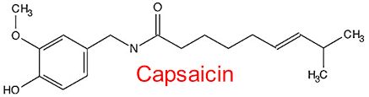
Other carotenoid include zeaxanthin,capsorubrin,rubixanthin,phylofluene,lutein,cryptoxanthin,capsorubin and few xanthophylls.
-carbohydrate reported in chillies are fructose,galactose,sucrose.
-Tocopherol (vit E) present in trace amount.

Slide 48
Uses- Stimulant, counter irritant, rubefacient,in sore throat, scarlatina and yellow fever.
Internally used as carminative, stomachic,dyspepsia.
Used for the relief of rheumatism and lumbago.
Used in the treatment of migraine & cluster headache.
Marketed product-
Capsigyl-D–Shalaks.
Deepact-Lupin herbal laboratory.

Slide 49
Shellac
Synonym- Lac,lacca.
B.S- it is the resinous protinous secretion of lac insect Laccifer lacca Kerr. Family-Lacciferidae.
Composition-contains 80% of resin,2% of colouring matter.6% wax & some volatile oil.
Alluritic acid is the majour constituent of resin and other like shelloic acid and its isomer ie carollic acid & butolic acid are the minor constituents.
Colouring matter contain lacaic acid

Slide 50
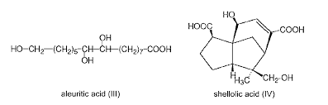
Uses- mfg. of sustained released medicament.
-Vernished preparation.
-Mfg of paper, cement,ceiling wax

Slide 51
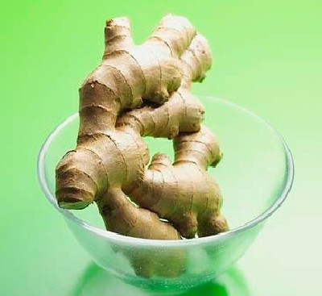
Zingiber officinalis - Ginger
GEOGRAPHICAL SOURCES
  Jamaica
  China
  India Africa
HISTORY
Cultivated in India from the earliest times. Used by Greeks and Romans and was a common article of commerce in the European Middle Ages.

Slide 52
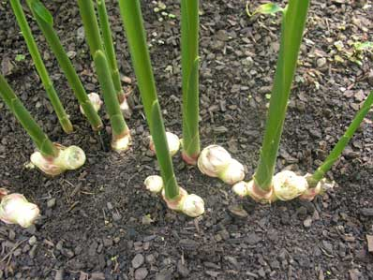
CULTIVATION & PREPARATION
Grows well in subtropical temperatures with high rainfall.
Grown by vegetative means.
Mulching or is necessary as the plant rapidly exhausts minerals from the soil.
When the stems wither, the rhizomes are ready for collection.
Dried.

Slide 53
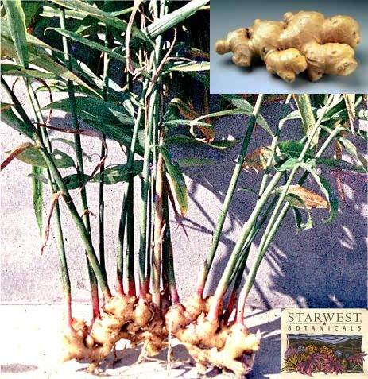
MACROSCOPICAL FEATURES
Scraped/peeled herb has little resemblance to the fresh herb (loss in weight & shrinkage).
Occurs in branched pieces “hands” or “races”.
Buds
No cork
Aromatic odour & pungent taste.
Unscraped rhizome: resembles scraped herb –
Covered with cork (brownish layers)

Slide 54
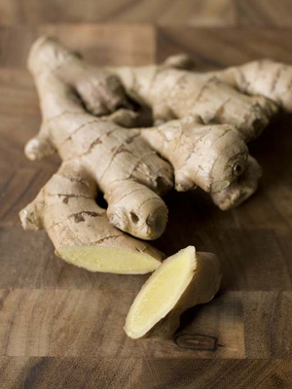
MICROSCOPICAL FEATURES
Cork cells – high starch content
Cork cells are absent in the scraped drug.
Outer zone of flattened parenchyma & inner zone of normal parenchyma.
Oil cells scattered in the cortex.

Slide 55
Zingiber officinale - CONSTITUENTS
Volatile oils (1 – 2%)
  Camphene
  Cineole
  Citral
  Borneol
Gingerol – pungent component – Anti-inflammatory
Shogaols – increases bile secretion
Sesquiterpene HC’s
  Zingiberene & Zingiberol (Sesquiterpene alcohol)
Resins
Starch
Mucilage

Slide 56
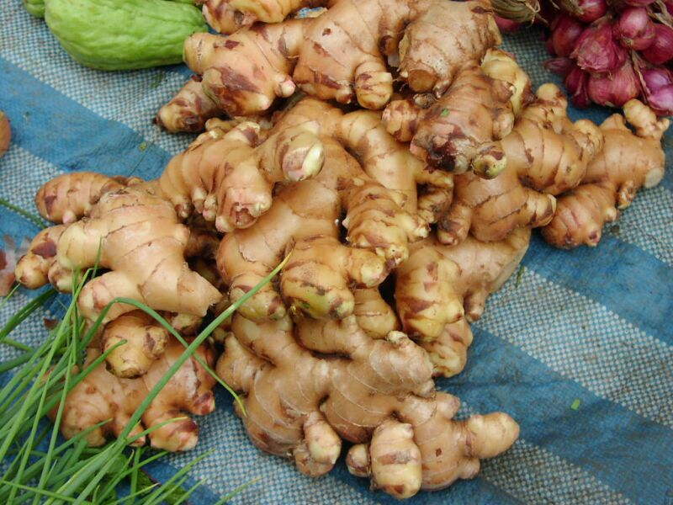
Zingiber officinale
VARIETIES
  Chinese Ginger – sliced
  African ginger – darker (cortex is grey – black in colour); lacks the odour but more pungent than Jamaican herb.
ALLIED DRUGS
  Japanese ginger – Z. mioga
  Preserved ginger – undried rhizomes preserved by boiling in syrup.
ADULTERANTS
  Spent ginger
  Vegetable adulterants (detected with microscopical examination).

Slide 57
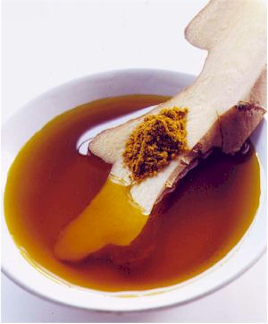
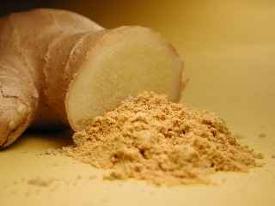
USES & ACTIONS
ACTIONS
Carminative
Stimulant
Anti-emetic
Anti-bacterial & Anti-fungal
Sesquiterpene lactones – Anti-ulcer
Gingerol – pungent component – Anti-inflammatory
Shogaols– increases bile secretion & enhanced GIT activity
USES
Motion Sickness
Morning Sickness

